Slide 1


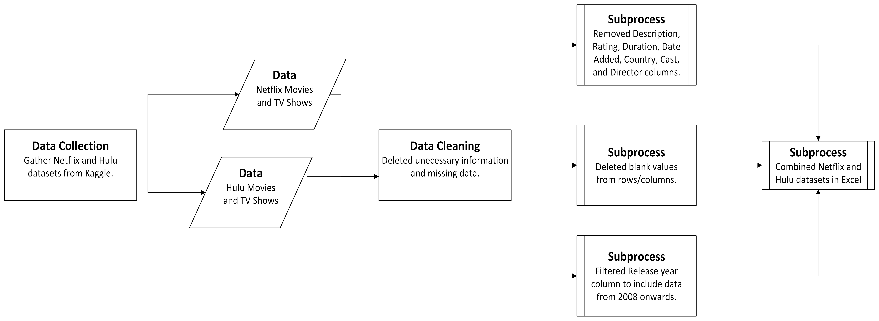

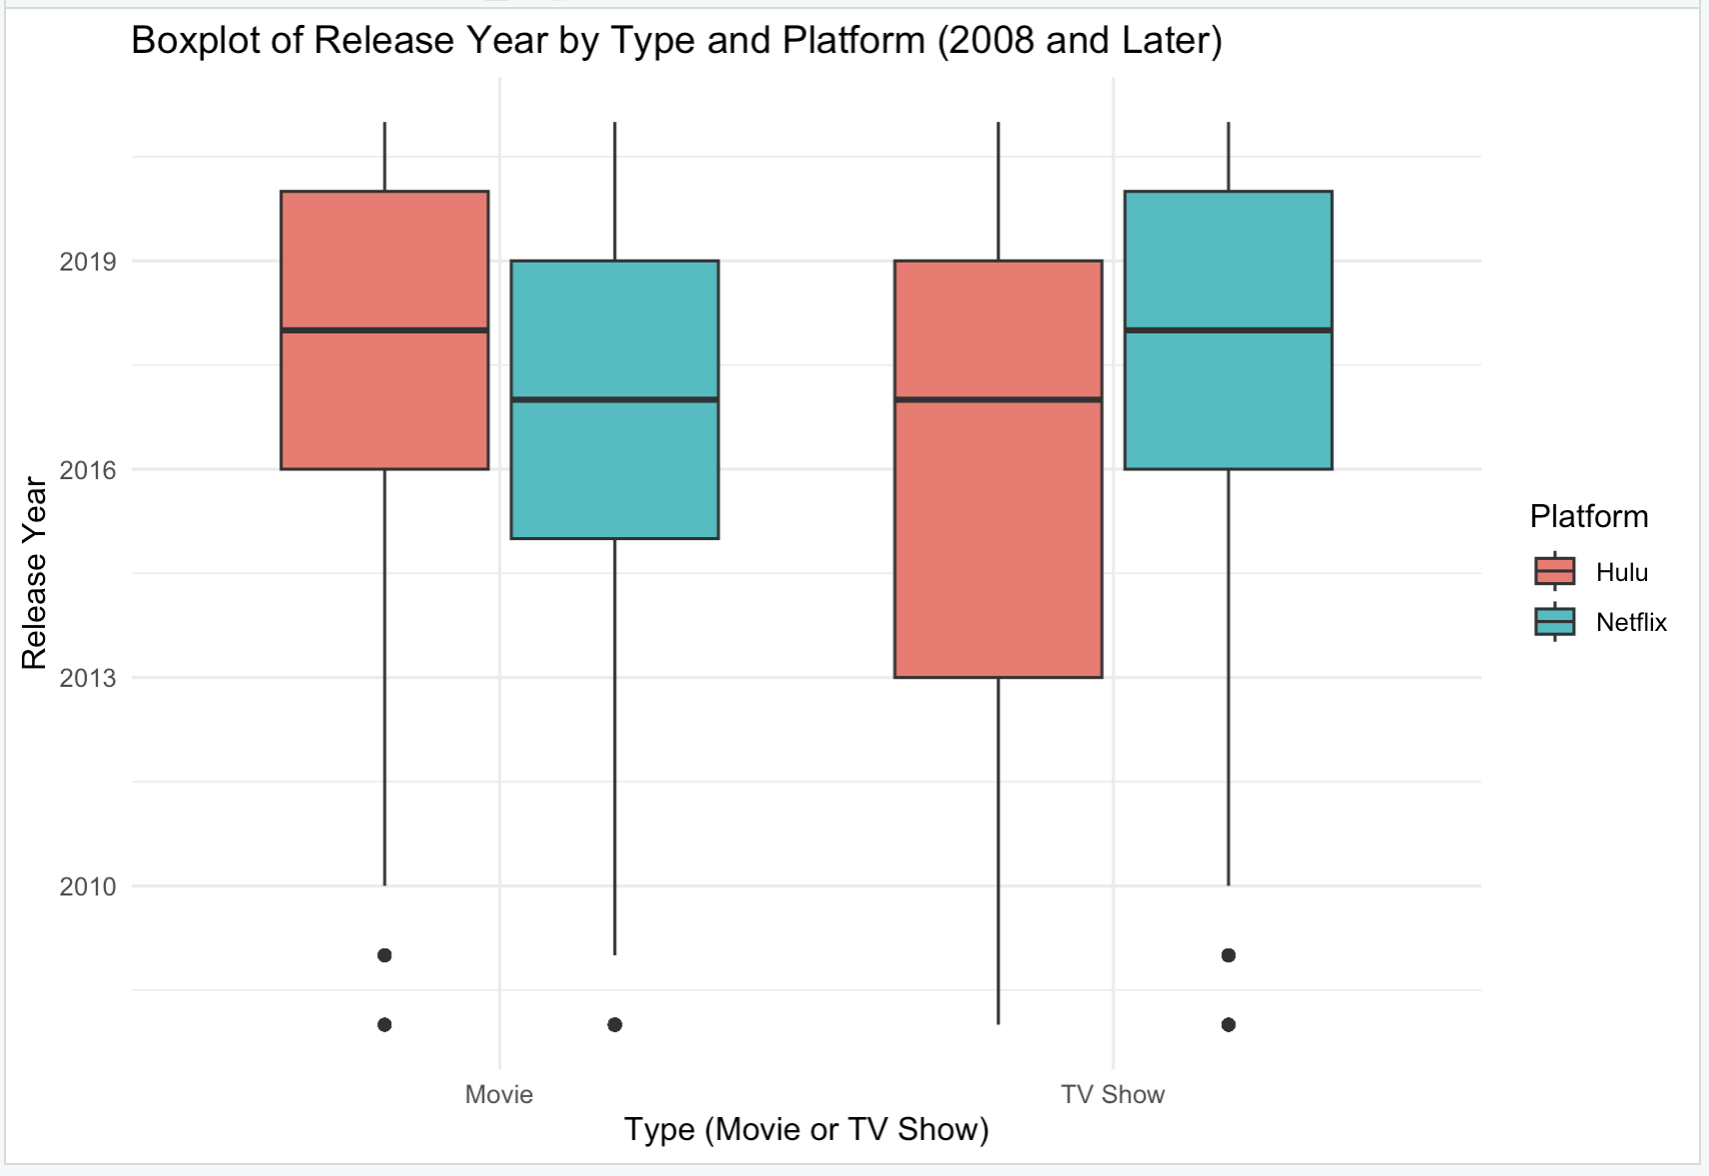
Netflix vs. Hulu: Analyzing Streaming Service Content
Ayesha Abdulahi
Department of Computational and Data Sciences, George Mason University, Fairfax, VA
Background or Abstract
Preprocessing
Count of title | Column Labels
Row Labels | Hulu | Netflix
<2008 | 555 | 1045
2008-2012 | 395 | 901
2013-2017 | 809 | 3130
2018-2022 | 1285 | 3721
Discussion
Streaming services have surpassed traditional cable media in demand and popularity. Both Netflix and Hulu being platforms revolutionizing this media consumption.
These are the key steps taken to process the data for analysis and visualization using Excel.
Removed blank values and columns that were unnecessary.
Filtered the year column for Netflix and Hulu dataset from 2008 onwards.
Merged Netflix and Hulu datasets.
This analysis revealed the content type difference between Netflix and Hulu. Netflix offers both a wider variety of tv shows and movies for their users to choose from than Hulu. Netflix has a higher proportion of movies than tv shows while Hulu has a higher proportion of tv shows than movies. Additionally, the line chart shows that Netflix emphasizes offering users a mixture of newer and older content while Hulu tends to focus on newer content. A limitation of this data is having a restrictive catalog that doesn’t include every regions tv shows and movies due to licensing agreements.
This research will explore content library differences between Netflix and Hulu. The research will also examine several reasons consumers prefer Netflix over Hulu.
Table: Netflix offers a significantly larger collection of newer and older titles than Hulu.
Figure 1: Netflix Logo.
Research Questions
How do content types differ amongst Netflix and Hulu’s catalog?
How does the release year of a movie and show differ between Netflix and Hulu?
Workflow Diagram: The processes I performed throughout this Research Project.
Conclusion
Methods or Analysis
This research is important because it shows Netflix and Hulu catalog strategy when deciding what content to offer their users. Since the streaming space is rapidly evolving, analyzing this data reveals how Netflix and Hulu differentiate from one another.
Related Research
To help answer our research question, descriptive analysis is an approach that will be firstly used to reveal the content count difference between Netflix and Hulu. Next, we will group release years to compare if the platforms tend to upload newer or older content. In other words, we will make distributions to examine release years.
Examining Netflix and Hulu’s different content strategy approaches will reveal users’ preference and how Netflix has more users than Hulu. This study contributes to science by providing analysis of consumer trends and behavior.
Future Work
Line Chart: Most of Netflix’s titles came out after 2014 and Hulu’s line gradually grows experiencing a surge around 2016.
Analyze Other Streaming platforms such as Disney+, HBO Max, Amazon Prime, Paramount+, Apple TV, and Peacock.
Perform descriptive analysis and even possibly correlation analysis on the other datasets
Compare other streaming platforms results to Netflix and Hulu
Data
Results
Both of my datasets are from Shivam Bansal on Kaggle and are structure datasets. The structured data come in a zip file with an excel and csv spreadsheet. The first dataset is titled “Netflix Movies and TV Shows” and is 3.4 MB as it contains 8,807 rows and 9 columns.
My Second dataset is titled “Hulu Movies and TV Shows” and is 1.1 MB with 3,045 rows and 9 columns. Both datasets consist of the same column names. The columns are movie name, tv show name, director, cast, where the content was recorded, release date, when Netflix/Hulu released the content, rating, and duration.
Visualizations below depict findings for the research topic:
References
Bansal, S. (n.d.-a). Hulu Movies and TV Shows. Kaggle. https://www.kaggle.com/datasets/shivamb/hulu-movies-and-tv-shows
Bansal, S. (n.d.-b). Netflix Movies and TV Shows. Kaggle. https://www.kaggle.com/datasets/shivamb/netflix-shows
Pie Chart: Proportion of TV Shows and Movies on Netflix and Hulu.
Box Plot: Netflix’s catalog is more diverse than Hulu’s and Hulu tends to focus on uploading newer releases (especially movies).

